Slide 1

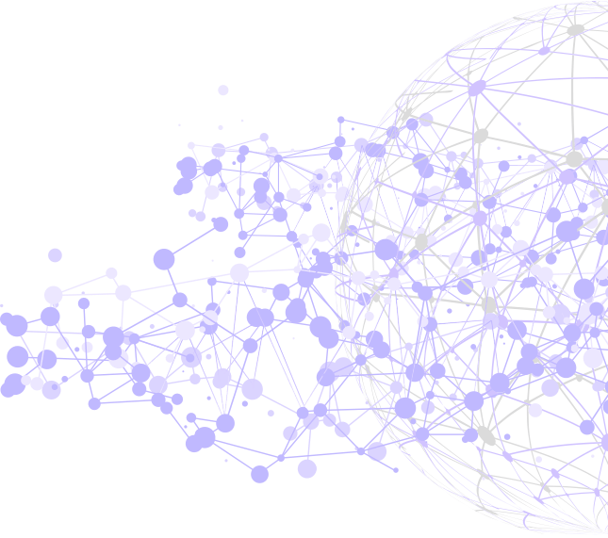


DWE – Seminar Web Engineering
Security in SoLiD Applications
Presented by:
SreeKanth Reddy Seelam (474430)
Mayur Lakhani (485315)
Advised by:
Valentin Siegert

Slide 2


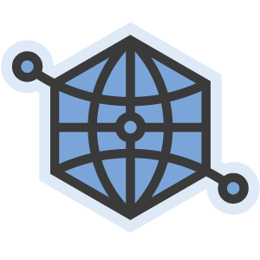

1
Secuity in SOLID

Slide 3
2
01
Current Trends
& Issues
02
Centralization
Agenda
03
Solid Intro with
Decentralization
04
Security in Apps
05
Demo

Slide 4
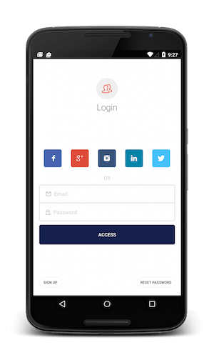





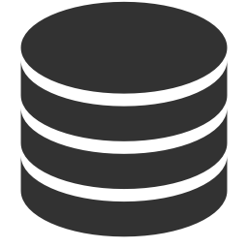




3
Current Trends in APPs
Business
Login via Single Sign on
Social apps
Documents
Central Server

Slide 5
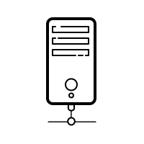




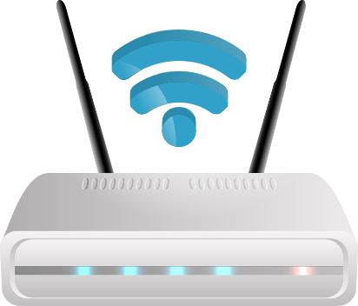
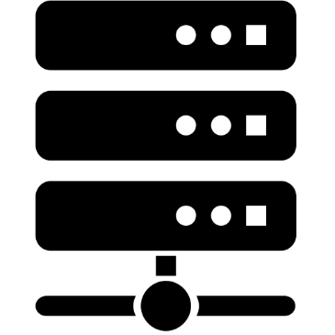

4
Centralize Architecture with Web Apps
Centralized App Architecture
Cenetral Serve
System
Centralized Apps
Documents
Internet
Server System
Devices

Slide 6
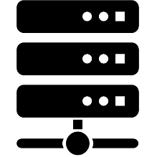
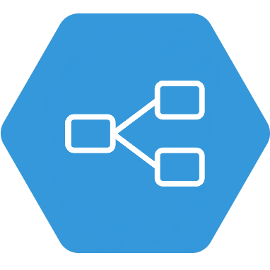

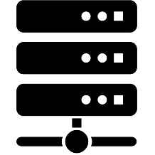
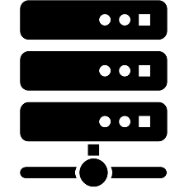
5
Traditional way of apps not suitable
Incompatible
App related Logic
Incompatible
Client of Centralized Web App
Server
Incompatible
server
Hard coded sequence of interface

Slide 7


6
SoLiD
Solid SoLiD
Derived from “Social Linked Data”
SoLiD
Introduction
A set of conventions and tools for building decentralized social application
The project led by Prof. Tim Berners-Lee,
inventor of the World Wide Web, taking place at MIT
In order to provide true data ownership as well as improved data privacy

Slide 8


7
SoLiD Features
SoLiD
Specification
True Data Ownership
Faster
Data Transfer
Modular Design
Data Reliability
Reusing existing data

Slide 9
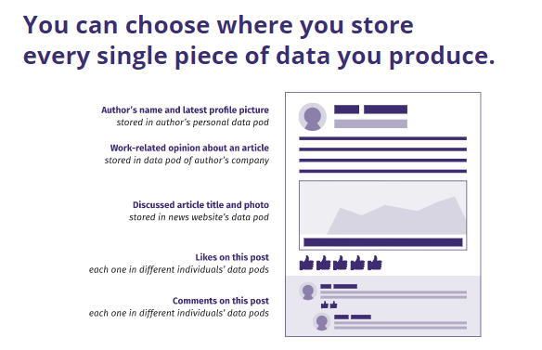
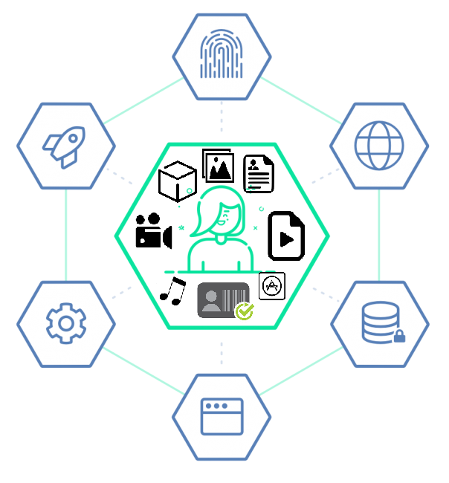
8
SoLiD POD
Source: https://inrupt.com/solid
https://rubenverborgh.github.io/Solid-DeSemWeb-2018/#decentralized-data

Slide 10



9
Centralized Web Applications
DeCentralized Web Applications
Social feeds
Photo Gallery
Meeting
Scheduler
Linkedln:
My Contact list 2
FB:
My Contact list 1
Mutiple data silos
My Pictures 1
My agenda
My agenda 1
Doodle:
My agenda 2
Personal
data pod
My Pictures
My Contact list

Slide 11
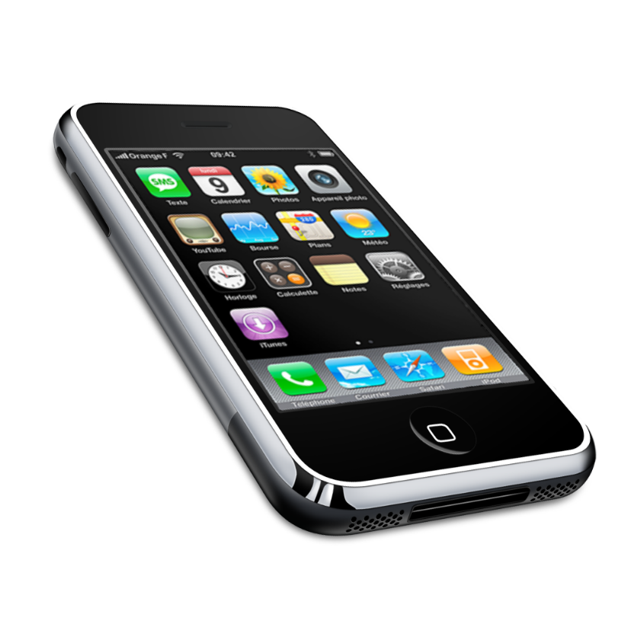

10
Decoupled SoLiD App + POD
Secure User POD
Trusetd Social App
permission/denied access
Fig: SoLiD apps presented with Pod

Slide 12
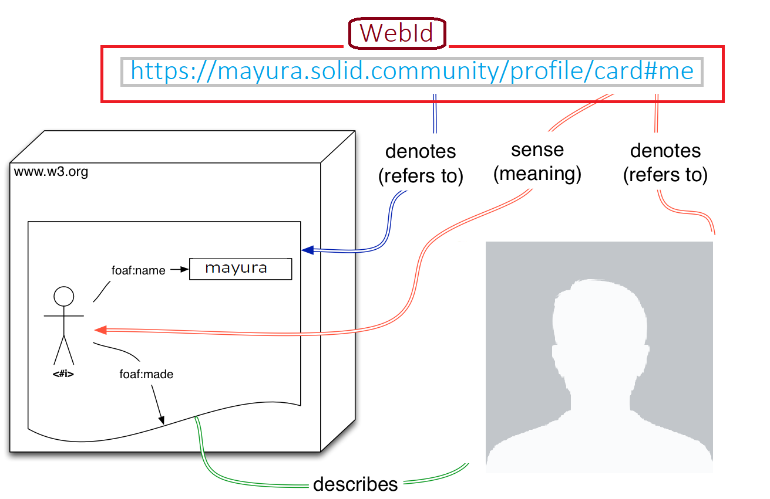
11
WebID Identity
WebIDs provide globally unique decentralized identifiers, enable cross-service federated SignIn, prevent service provider lock-in, and give users control over their own identity.
Source: https://www.w3.org/2005/Incubator/webid/spec/identity

Slide 13
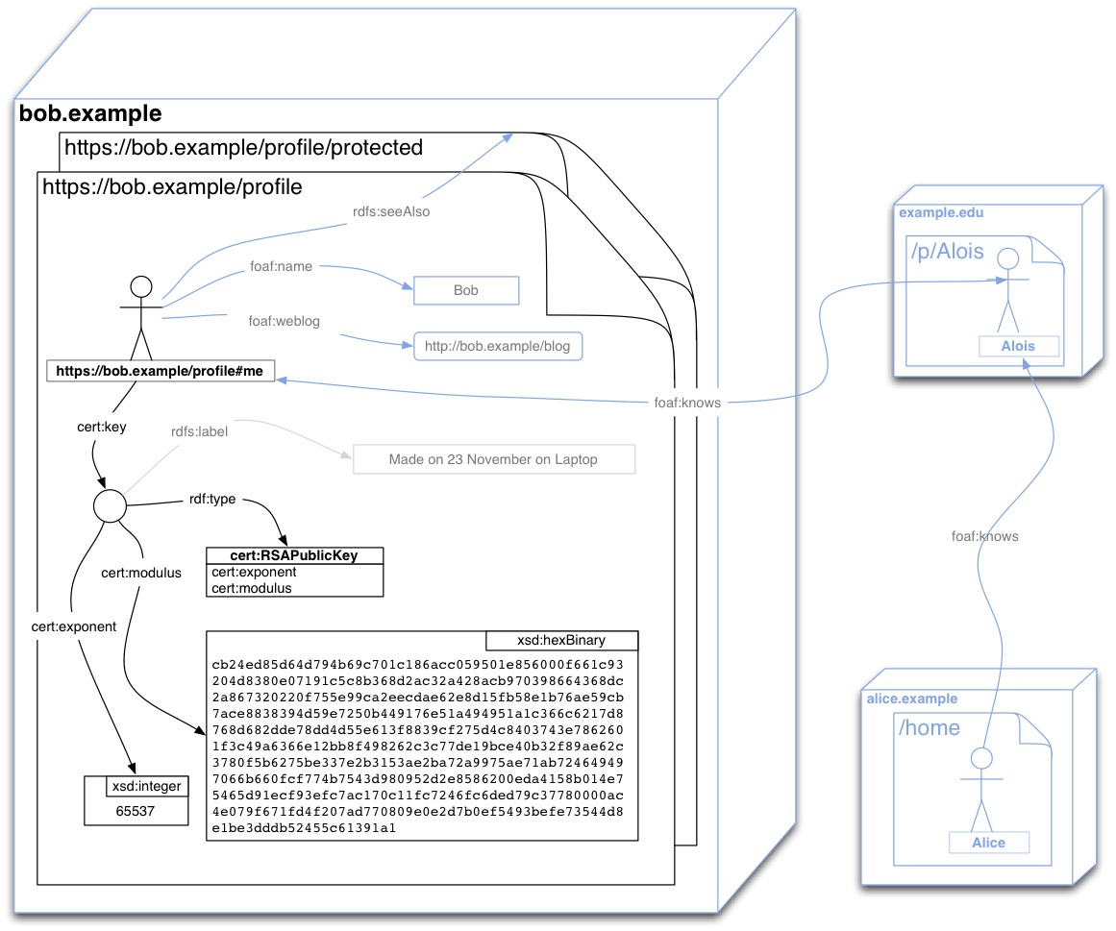
12
WebID Profile
Document
Source: https://www.w3.org/2005/Incubator/webid/spec/tls/#the-webid-profile-document

Slide 14
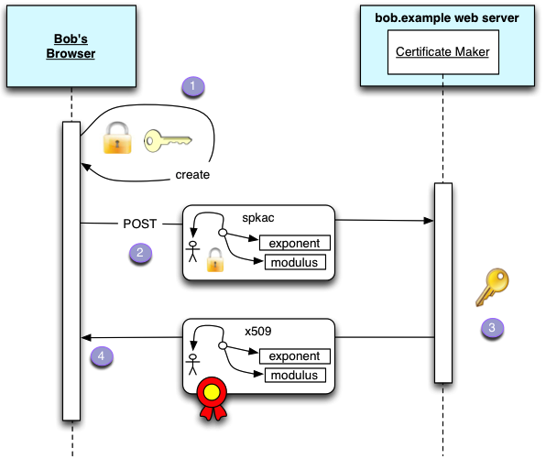
13
Certificate creation
<form action="/srv/certificateMaker" method="POST">
<keygen challenge="random" name="spkac"/>
<input type="submit" name="Create Certificate"/>
</form>
Source: https://www.w3.org/2005/Incubator/webid/spec/tls/#certificate-creation

Slide 15
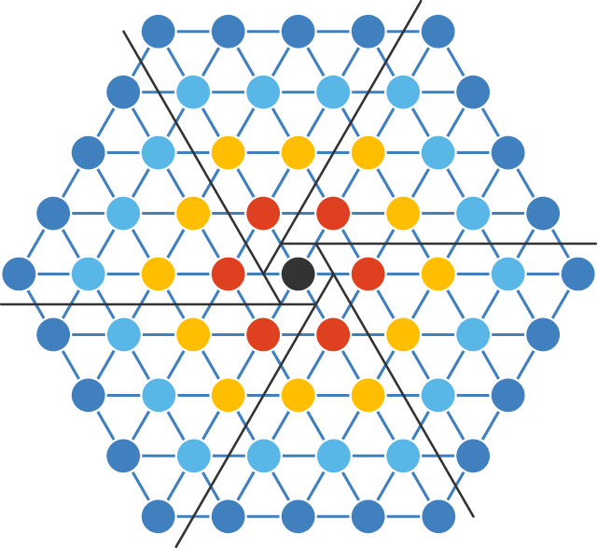
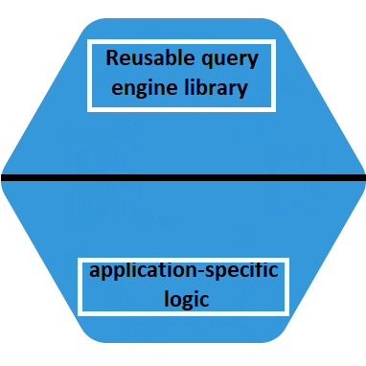
14
Decentralize Architecture with
different App Technique
Interface
Interface
Interface
Interface
Interface
Result Stream
Query
Interface
Interface
Interface
Decentralized Web App
Interface
Dynamic sequence of interface

Slide 16
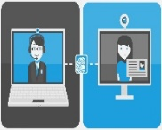

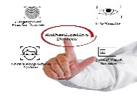

15
Security in SoLiD
Primary Authentication
WebID - OIDC
Alternative Authentication
WebID - TLS
OAuth2/OpenID
Connect protocols
UserID - Pwd
WebID - TLS protocol
WebID-TLS
Delegation

Slide 17

16
Alice’s Server
Bob’s Server
Bob’s
Client
TLS-Light
Service
Guard
WebId
Verifier
Cache
Protected
Resource
Bob’s Profile
1
TLS setup
Access Control check
Social Graph
2
3
Bob
Alois
TLS agent
cert req client
Alice
Certificate &
private Key
verification
4
WebID Verification
5
exponent
6
Modulus
Authorization
7
8
WebID TLS
Authentication
Source: https://www.w3.org/2005/Incubator/webid/spec/tls/

Slide 18
17
WebID OIDC – Two servers are involved for data Exchange
Alice
Direct Browser request or AJAX or API Client Request
Bob
1
Requested for Bob.com (unauthorized)
401 unauthorized
Provider Selection
Sign In
2
Popup.html - By selected WebID service provider (WebID URI)
https://alice.solidtest.space/signIn => Authentication via WebID TLS
Local Authentication
3
4
User Concent
Screen to also signIn in Bob.com
5
Authentication Response
redirected to https://bob.com/res1
Server of Bob received signed Id token from alice.solidtest.space
6
Deriving webId URI
Bob server controls resource – validates ID token, extraction Alice WebID URI
And now Alice is signed In in Bob server
7
WebId Provider Confirmation
Data extchange
Bob.com confirms now Alice authorized OIDC provider

Slide 19



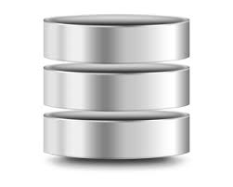






18
WebID TLS Delegation
Web Agents
:has Delegate
:IdentifiedBy
User Y
Virtuoso Data Junction Box
Profile Doc
describedBy
:IdentifiedBy
Authentication
(HTTP, Agent On-Behalf-Of User x)
Enterprise RDBMS
SQL and/or NoSQL
Mobile Agents
(Mobile Agent
On-Behalf-Of User Y)
HTTP,
ODBC,
JDBC,
ADO.NET ETC
Attribute-based Access Control
(for X and/or Y)
Secure Access Layer
Conceptual Data Layer
Web of Docs(www),
Terms(LOD) and Sentences (Semantics)
describedBy
:IdentifiedBy
(Other Agent
On-Behalf-Of User X or Y)
Other Agents
:has Delegate
:IdentifiedBy
describedBy
:IdentifiedBy
User X
Various Web & SOA
Service API’S
Profile Doc
Source: http://vos.openlinksw.com/owiki/wiki/VOS/WebIDTLSDelegationWhatWhyHow

Slide 20
References
Https://github.com/solid/solid-spec [Online – GitHub 10.05.2019]
https://solid.mit.edu/ [Online 10.05.2019]
https://solid.inrupt.com/how-it-works [Online 10.05.2019]
https://rubenverborgh.github.io/Solid-DeSemWeb-2018 [Online10.05.2019]
http://vos.openlinksw.com/owiki/wiki/VOS/WebIDTLSDelegationWhatWhyHow [Online10.05.2019]

Slide 21


